Slide 1
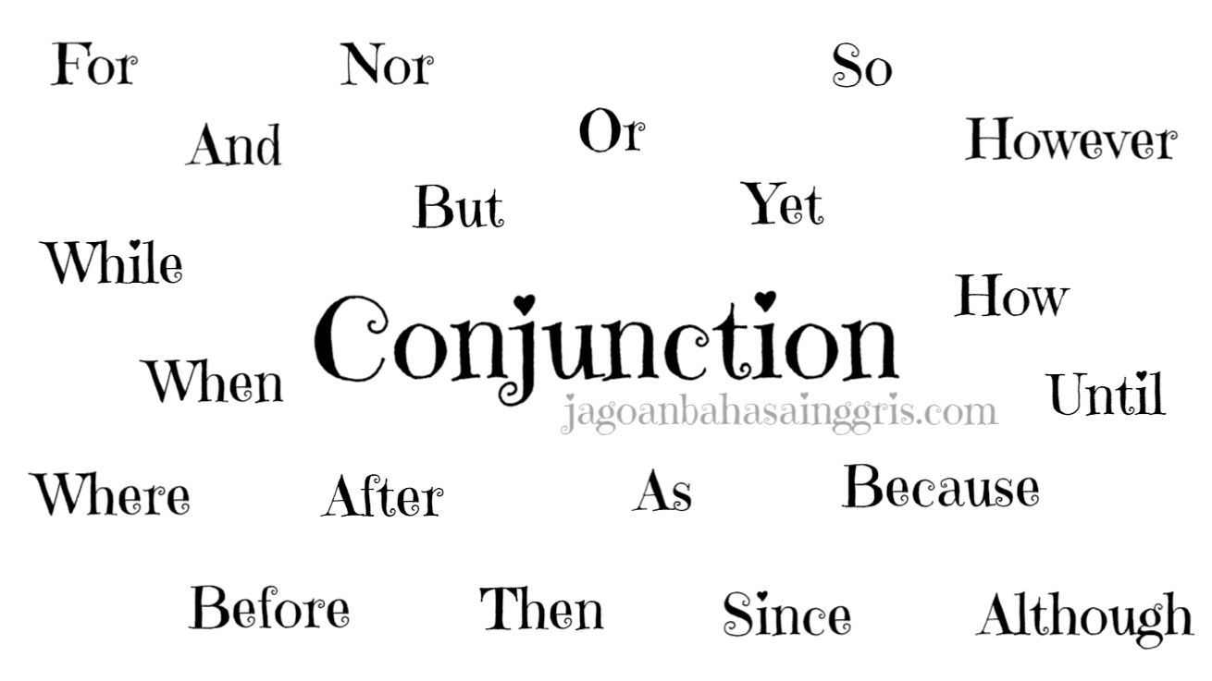
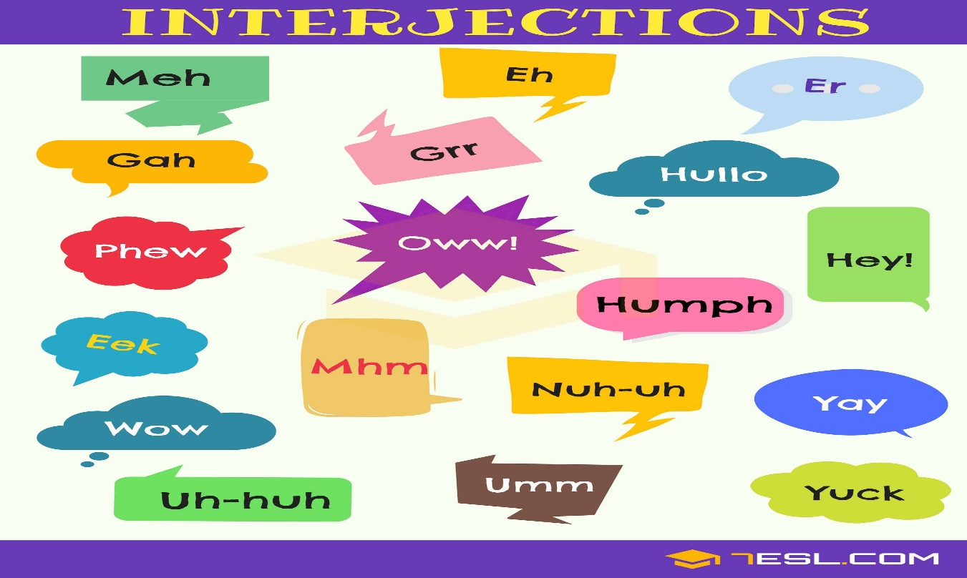
CONJUNCTION AND INTERJECTION
KATA PENGHUBUNG DAN KATA SERU

Slide 2
CONJUNCTION/KATA PENGHUBUNG
Conjunction dalam bahasa Indonesia memiliki arti “kata penghubung”. Fungsi dari conjunction adalah untuk melengkapi sebuah kalimat atau untuk menyatukan dua klausa menjadi suatu kalimat yang padu.

Slide 3
Conjunction terbagi menjadi 2 (dua) jenis:
1. COORDINATING CONJUNCTION
2. SUBORDINATING CONJUNCTION

Slide 4
COORDINATING CONJUNCTION
Jenis conjunction yang berfungsi menghubungkan word+word (kata+kata), phrase+phrase (frasa+frasa) atau clause+clause (klausa+klausa) di dalam kalimat yang memiliki tingkatan struktur bahasa yang sama.

Slide 5
Beberapa contoh kata yang termasuk ke dalam COORDINATING CONJUNCTION :
but : tapi
and : dan
or : atau
nor : atau (negatif)
so, therefore, hence: maka dari itu, oleh karena itu

Slide 6
Contoh : 1. Word+Word (Kata+Kata)
- He eats bread and butter.
N conj N
- The man has big and strong muscles.
adj conj adj

Slide 7
2. Phrase+Phrase (Frasa+Frasa)
- He eats the bread and the butter
NP conj NP
-His muscles are very big and very strong
AP conj AP

Slide 8
3. Clause+Clause (Klausa+Klausa)
- I waited for him but he didn’t come.
Clause 1 conj Clause 2
- She requested him for help but he didn’t help her.
Clause 1 conj Clause 2

Slide 9
SUBORDINATING CONJUNCTION
Jenis conjunction yang berfungsi menghubungkan anatara Dependent Clause (Klausa Terikat) dengan Independent Clause (Klausa Tak Terikat).

Slide 10
Beberapa contoh kata yang termasuk ke dalam SUBORDINATING CONJUNCTION :
although, though : meskipun, walaupun
because, cause, for : karena, sebab
before : sebelum
after : setelah
if : jika
since : sejak
till, until : sampai, hingga
what : apa
where : dimana
when : ketika
whenever : kapanpun
whether : apakah
while : sementara itu
during : selama

Slide 11
CONTOH KALIMAT
Although : Although she is sick, she goes to school.
Dependent Clause Independent Clause
Because : The pilot don’t do the flight because the situation is not safe.
Independent Clause Dependent Clause
If : If I have much money, I will buy the expensive car.
Dependent Clause Independent Clause

Slide 12
INTERJECTION
Interjection adalah kata singkat dalam bahasa inggris yang menggambarkan ungkapan perasaan/emosi seseorang.
Ah : Ah! I get high score in the math exam. (ah menggambarkan ungkapan gembira)
Aha : Aha! I’m so happy because I will be free for a week. (ah menggambarkan ungkapan gembira)
Wow : Wow! That’s amazing.

Slide 13
EXERCISES
I like sugar in my tea, .... I don't like milk in it.
A. and C. or
B. but D. so
Listen to the story .... answer the questions in complete sentences.
A. and C. but
B. because D. or
Is it Thursday .... Friday today?
A. and C. or
B. but D. then

Slide 14
He was late .... the bus didn't come.
A. although C. but
B. because D. or
We were very tired .... happy after our flight to Sydney.
A. and C. or
B. but D. so
They climbed the mountain .... it was very windy.
A. although C. or
B. nor D. so
.... Lenny was watching the planes his wife was reading in the car.
A. And C. So
B. But D. While

Slide 15
I'll text you .... I have arrived in Toronto.
A. after C. so
B. or D. then
Neither my brother .... my sister own a car.
A. and C. nor
B. but D. so
The sun was warm, .... the wind was a bit too cool.
A. after C. so
B. nor D. yet

